Slide 1
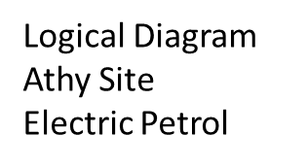
VLAN2
Hosts
10.45.1.16/24
VLAN3
Staff Radio
10.45.1.0/24
VLAN1
ISP
10.45.1.15/24
VLAN4
Power Infrastructure
10.45.1.1/24
.9
VLAN16
Links
10.45.1.13/24
SWITCH
VLAN5
Technical Clients
10.45.1.2/24
1
192.168.2.20
192.168.2.20
192.168.2.20
.10
.10
HSRP .20
.10
192.168.2.20
VLAN15
Routers
10.45.1.12/24
192.168.2.20
.10
Router 1
192.168.2.20
VLAN6
Infrastructure Servers
10.45.1.3/24
.10
192.168.2.20
.10
.10
192.168.2.20
VLAN14
Loopbacks
10.45.1.11/24
.10
.10
Router 10
(VRRP)
VLAN7
Telephony
10.45.1.4/24
192.168.2.20
.10
192.168.2.20
dc1
AAA, DNS, DHCP
192.168.6.21
.10
192.168.2.20
Router 2
.10
VLAN13
ClusterChat
10.45.1.10/24
.10
.10
VLAN8
HVAC Infrastructure
10.45.1.5/24
.10
192.168.2.20
192.168.2.20
192.168.2.20
192.168.2.20
VLAN12
Server
10.45.1.9/24
VLAN9
Storage
10.45.1.6/24
VLAN11
Security Cameras
10.45.1.8/24
VLAN10
NetMan
10.45.1.7/24
dc2
AAA, DNS, DHCP
192.168.6.22

